Slide 1
Increasing Grand Canyon Council's Donation through Data-Driven Insights
Organization: Grand Canyon Council
ASU team member: Austin, Julis, Zih Han, Darshan

Slide 2
RFM Scoring Criteria
Metric | Score 5 | Score 4 | Score 3 | Score 2 | Score 1
Recency | Most recent 20% | 20%-40% | 40%-60% | 60%-80% | Oldest 20%
Frequency | Most frequent 20% | 20%-40% | 40%-60% | 60%-80% | Least frequent 20%
Monetary | Top 20% spenders | 20%-40% | 40%-60% | 60%-80% | Bottom 20% spenders
Scoring criteria is based on a year to year basis.
A “5” in recency indicate a donation in the last 20% of the year for that year.
A “5” in frequency indicates being in the top 20% of donors when measuring based solely on the number of times each donor donated in a given year.
A “5” in monetary indicates being in the top 20% of overall donation amounts for a given year.

Slide 3
RFM Segmentation Rule
Segment | RFM Score Rule
Active Donor | First digit is 511 (Recency=5)
Frequent Donor | Middle digit is 151 (Frequency=5)
High Monetary | Last digit is 115 (Monetary=5)
Segment | RFM Score Rule
VIP Donor | 555
High Recency, Low Value | 531
Lapsed High-Value | 114
* General Donor: None of the above
Segmentation was then conducted based on RFM scoring with “weight” considerations.
For example a 115, 151 and a 511 all show up a 7, but the value and what each donor represents are significantly different. Thus, need to be approached and segmented differently.

Slide 4
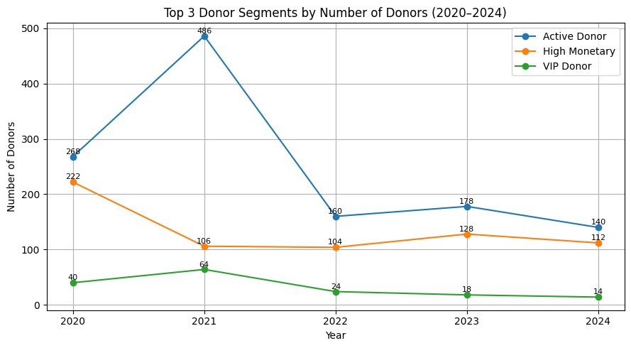
Problem Definition
Problem:
Active Donors decreased by over 70% from the 2021 peak.
High Monetary Donors declined by nearly 50% since 2020, despite slight temporary recovery in 2023.
VIP Donors dropped by over 75% from their peak in 2021.
Challenges:
Donor base shrinkage, especially among high-value segments.
Severe VIP donor attrition.
Sparse and inconsistent donor data limits predictive capabilities.

Slide 5
Data Challenges and Solution
Challenges | Solutions
Sparse donation & engagement data | Generated synthetic donor profiles
Inconsistent constituent information | Added synthetic attributes (wealth, engagement)
Limited behavioral depth | Enabled robust modeling and precise segmentation

Slide 6
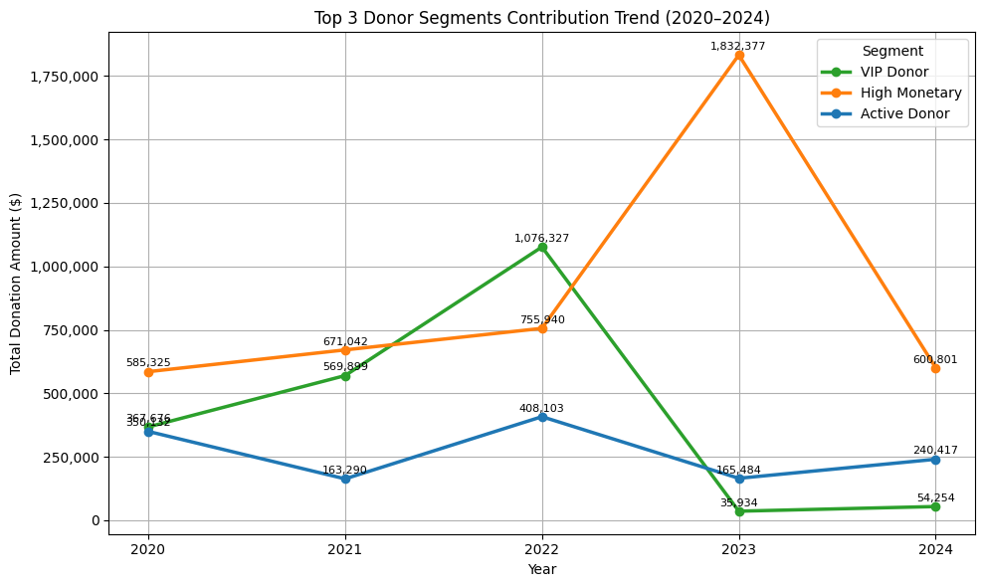
Opportunity Identification
In 2023, High Monetary Donors contributed over 90% of total donations
→ critical to fundraising success.
In 2022, VIP Donors contributed more than 50% but sharply declined
→ highlight potential.
Strategic engagement of High Monetary and VIP donors
→ drive sustained fundraising growth.
Opportunity: Deepen Relationships with High-Value Donors
Notes:
Through a thorough analysis of donor trends and contribution volumes, we clearly identified the key challenges facing Grand Canyon Council, and uncovered strategic opportunities focusing on High Monetary and VIP donors to drive future growth

Slide 7
Structured Analytics Roadmap
Data Collection & Cleaning
RFM Scoring & Segmentation
Predictive Modeling
Strategy Design & Impact Projection
Consolidated and prepared data.
Classified donor behaviors.
Forecasted donation behaviors.
Actionable fundraising strategies.

Slide 8
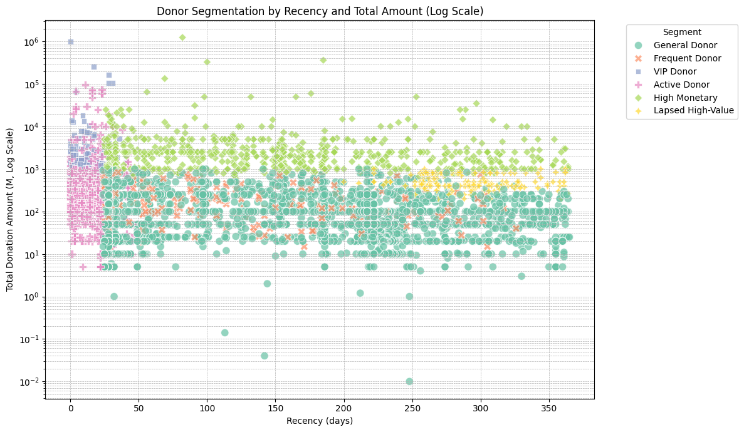
Key Insight #1 – RFM Behavioral Segmentation
Segment Highlights:
VIP Donors: High donation amount and recent activity.
High Monetary Donors: Consistent large donations over time.
Frequent Donors: Regular engagement, lower monetary value.
General Donors: Largest group, low donation amount, potential for nurturing.
Donor Profile with RFM Score.xlsx

Slide 9
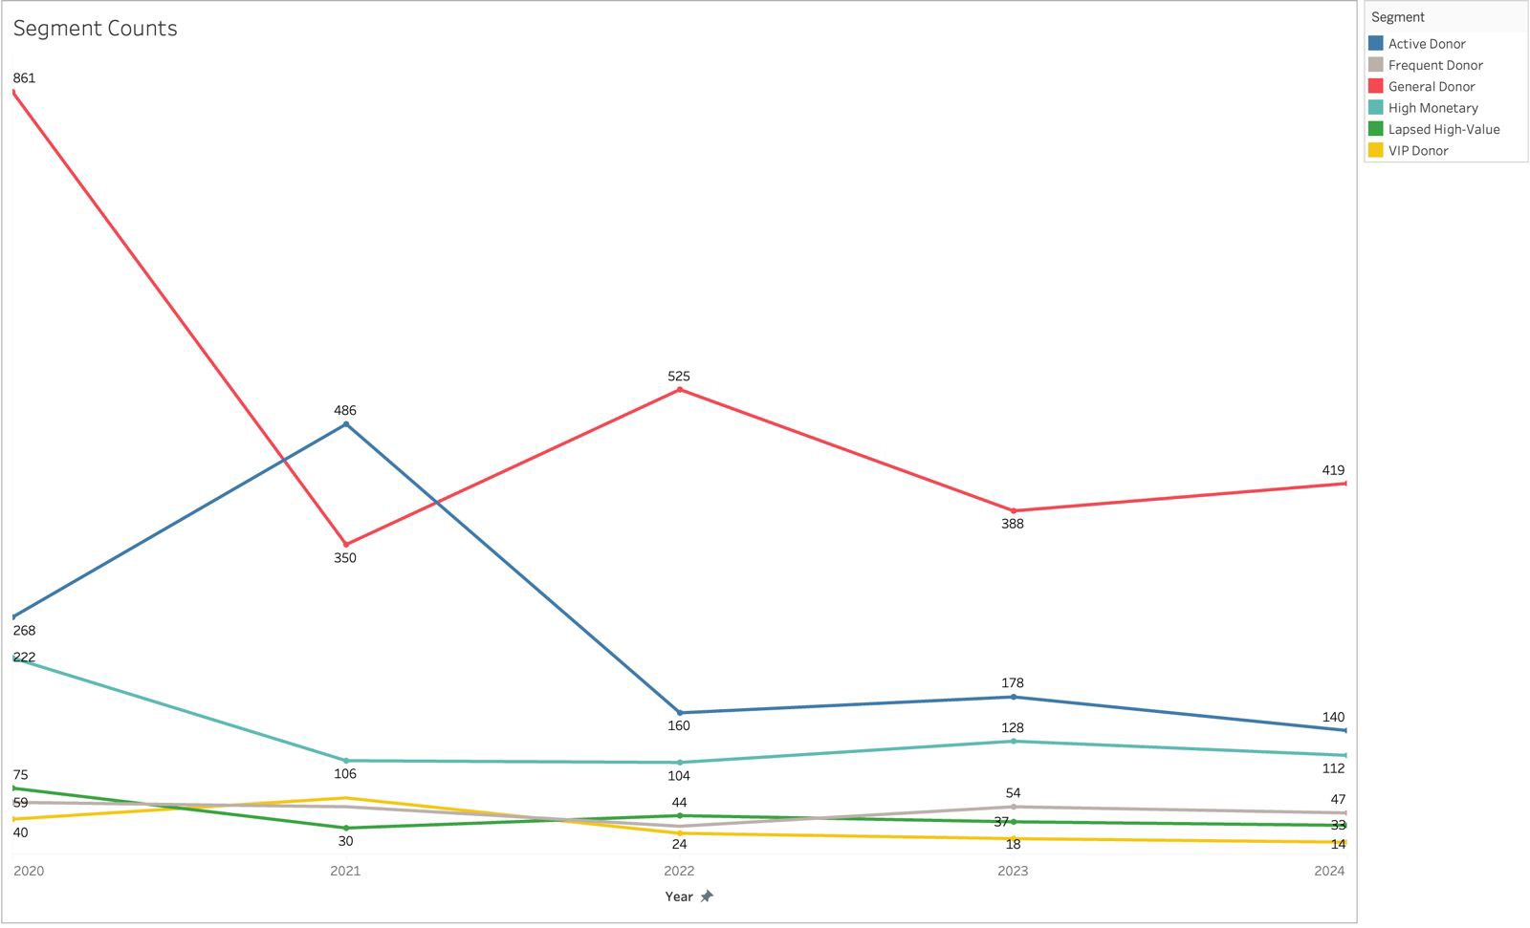
Key Insight #2 – Donor Trends
Donor Instability Signals Urgency for Action
General Donors dropped sharply from 861 in 2020 to 350 in 2021, showing instability.
Active Donors peaked in 2021 (486) but declined significantly in the following years, reaching 140 in 2024.
High Monetary Donors declined early (from 222 in 2020 to 106 in 2021) but have remained stable around 100–130 since then.
Frequent Donors and Lapsed High-Value Donors are gradually increasing from 2021 to 2024.
VIP Donors have consistently low counts, with no significant change over the years.

Slide 10
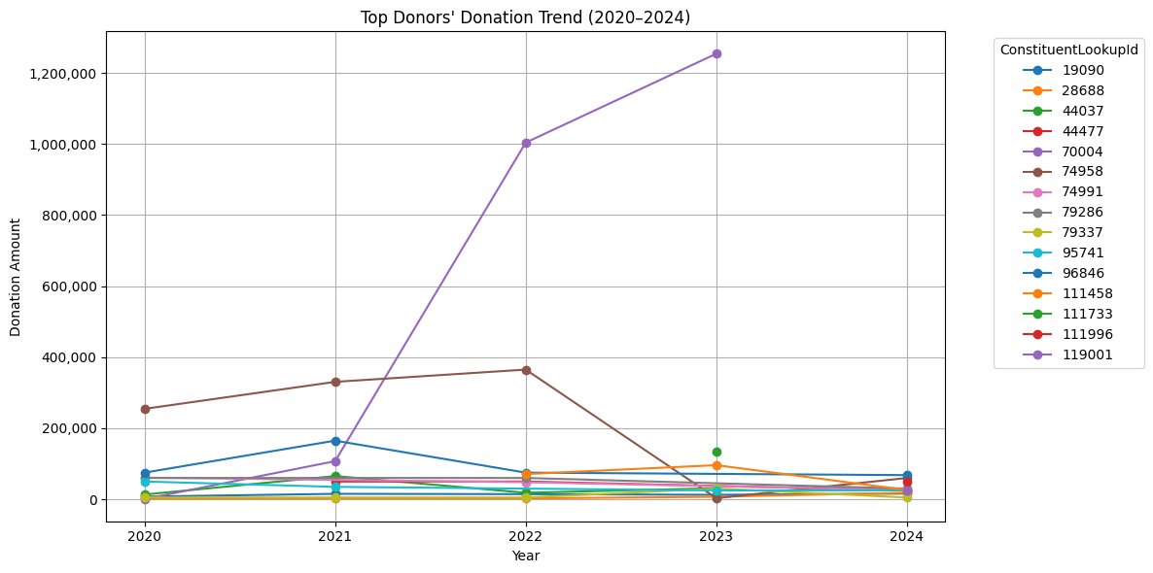
Key Insight #3 – Strategic Profiling of High-Value Donors
Category | Behavior Pattern | Donor IDs | Suggested Strategy
Consistent Growers | Donated every year with steady or increasing amounts | 28688 | Offer long-term engagement, naming opportunities, exclusive recognition
Returning Donors | Lapsed in one or more years but resumed giving | 44477,7499179286,95741 96846,111996119001 | Understand what brought them back, initiate personalized re-engagement
Declining Supporters | Significant decrease in donation amount in recent years | 79337 111458 | Send “We miss you” notes and feedback surveys to explore concerns
Lapsed Donor | No donations in 2024 | 44037 70004 111733 | Launch reactivation campaign: share impact stories, offer incentives, request updates

Slide 11
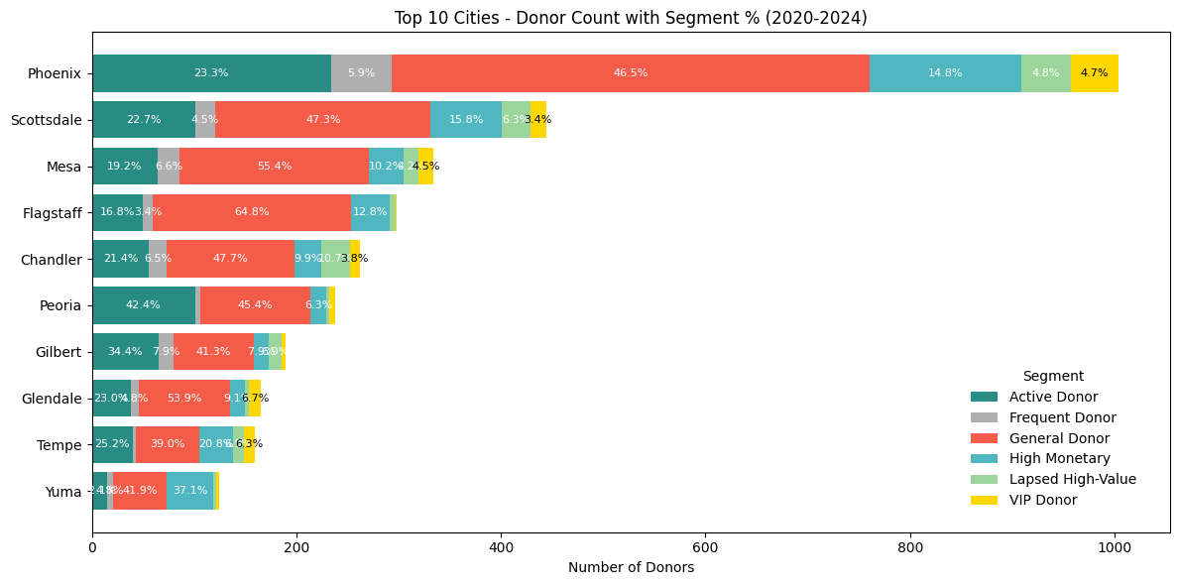
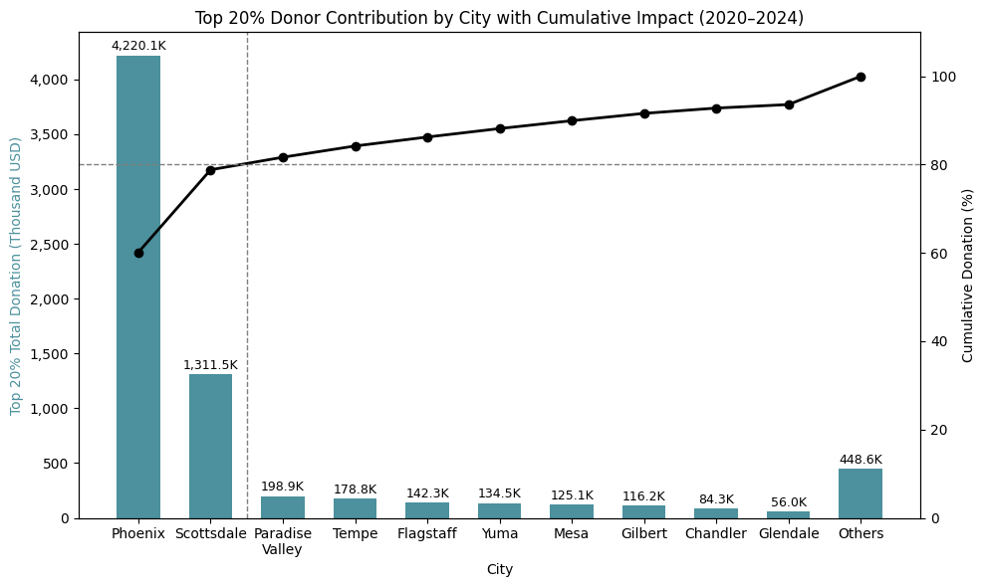
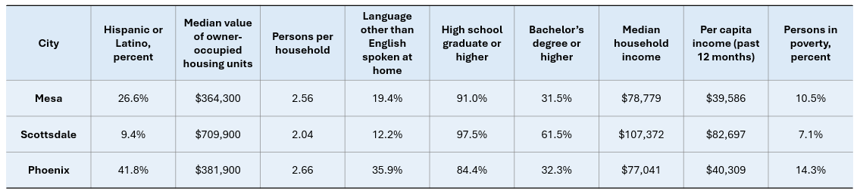
Key Insight #4 – Geography-Driven Strategy
Strategic Focus on High-Contributing Cities
Geographic Concentration: ~80% of high-value donations originate from Phoenix and Scottsdale.
Opportunity for Targeted Growth: Phoenix holds the largest base of General Donors for potential upgrades.
VIP Retention Priority: Scottsdale features a dense cluster of VIP and High Monetary donors.

Slide 12
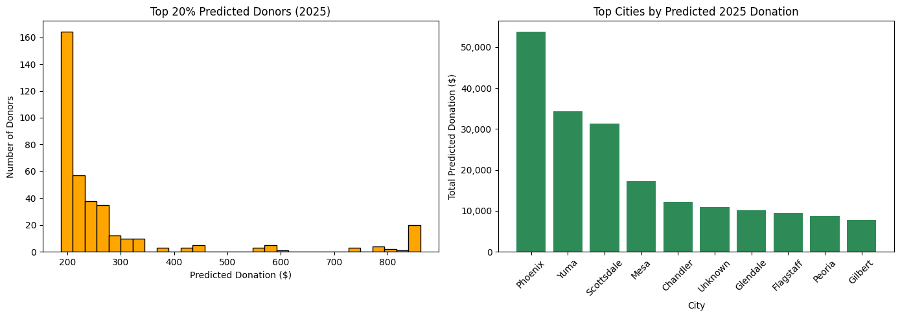
Key Insight #5 – Forecast-Driven Donor Strategy
Top 20% Predicted Donors (2025)
Identified through behavior-based forecasting using 2024 features and RFM scores.
These donors are projected to contribute a significant share of total donations (80/20 rule).
Most are concentrated under $1,000, indicating strong upgrade potential.
They are prime candidates for personalized stewardship, re-engagement, and targeted appeals.
Top Cities by Predicted Donations
Top cities by total donation: Phoenix, Yuma, Scottsdale
These regions offer the best opportunities for donor engagement events and staff focus.
Enables ROI-driven resource allocation by geography.

Slide 13
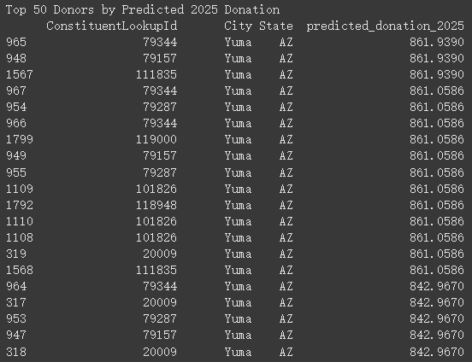
Evaluate the Predicted Result with Historical Data
Top 50 Predicted Donors
Many top donors got identical or nearly identical values
Example: Dozens assigned exactly $861.06, most from the same city (Yuma, AZ)
Indicates model lacks donor-level variation → limits personalization & targeting
Repetitive Predictions (Value Counts)
345 predicted values were assigned to 2 / more donors
Most common value: $3.93 assigned to 25 different donors
This pattern shows a lack of prediction granularity → reduces segmentation insight
Solution: Use Synthetic Data
Adds realistic variation and behavior patterns
Improves prediction diversity and donor differentiation
Enables more effective targeting and insight generation
Predicted Donation ($) | # of Donors Assigned
3.93 | 25
158.77 | 24
102.40 | 20
95.51 | 19
14.64 | 19
165.71 | 18
9.40 | 17
155.12 | 17
15.75 | 16
138.81 | 16

Slide 14
Business Value with Synthetic Data
Why It Matters
How We Used It
Fills gaps when real data is sparse or incomplete
Predicted donation potential using assumed behavioral traits
Enables early predictive modeling and strategy testing
Identified high-value synthetic donor profiles for targeting
Simulates potential donor behaviors not yet observed
Designed preliminary fundraising strategies ahead of complete data
Supports safe experimentation and planning
Validated feasibility of predictive modeling for future relationship management use

Slide 15
Short-Term Strategy – Maximize Existing Resources
Region | Strategic Action
Phoenix | Focus on general donors (46.5%) & activate upgrade path to High Monetary/VIP.
Scottsdale | Host high-end engagement events; leverage its 15.8% High Monetary & 6.3% VIP base.
Flagstaff | Re-activate under-engaged High Monetary donors (64.8%) with tailored campaigns.
Tempe & Chandler | Use local storytelling to convert large General Donor base into loyal supporters.
Peoria & Gilbert | Implement loyalty-building & retention pipelines.
Strategic Focus Areas:
Upgrade: Convert Phoenix General Donors into High Monetary/VIPs.
Engage: Retain top-tier donors in Scottsdale through VIP events.
Connect: Use storytelling to strengthen ties in Tempe and Chandler.
Retain: Build donor loyalty in Peoria and Gilbert.
Activate: Re-engage Flagstaff’s underutilized High Monetary donors.

Slide 16
Long-Term Strategy – Sustainable Growth
Data Collection
Predictive Modeling
Targeted Campaigns
Model Retraining / Optimization
CRM Integration / Fundraising Planning
Key Components of Sustainable Growth:
Data Enrichment: Expand donor profiles with behavioral and demographic attributes.
Predictive Automation: Implement automated tools to continuously forecast donation behaviors.
Insight-Driven Campaigns: Design flexible engagement strategies based on predictive outputs.
Continuous Learning: Retrain models regularly with new data to improve performance.
CRM Integration: Embed models into CRM workflows and annual fundraising plans.

Slide 17
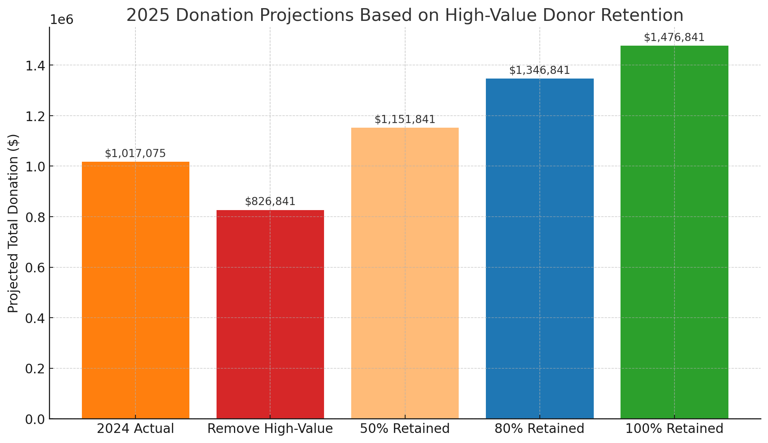
Impact Projection – Future Outlook
Projected Impact of Targeted Engagement
Boost Donations: Focus on high-value donors in Scottsdale, Phoenix, and Mesa (70% of total giving).
Retain Top Donor: Strengthen loyalty using behavioral profiles (RFM).
Campaign Efficiency: Prioritize high-ROI cities and donor segments.
Expand Donor Base: Inclusion of underrepresented groups, broadening community support.
Data-Driven Decision Making: All forecasts are based on behavioral modeling.
Scenario | Projected Donation | Strategic Role
2024 Actual | $1,017,075 | Benchmark for comparison
Base Forecast | $570,783 | Risk scenario if high-value donor loss continues
Sustained High-Value | $1,476,841 | Target scenario if we retain current high-value donors
Optimistic (+10%) | $1,624,525 | Opportunity if strategies improve loyalty

Slide 18
Conclusion
The project delivered a data-driven roadmap for optimized fundraising.
Key focus: maximize ROI by concentrating efforts on Phoenix and Scottsdale.
Build sustainable growth by diversifying engagement and adopting predictive insights.
Combining short-term actions and long-term strategies will empower the Grand Canyon Council to better support the youth of Arizona.

Slide 19
Feedback and Changes
Movement of slides to better facilitate the flow of information to the client in a more logical and comprehensible manner. (“Data Challenges and Solution”(slide) moved to being earlier in presentation.)
Implemented feedback on keypoints in our presentation. (RFM based slide broken into two slides with clarifying information added, thus allowing critical information to be more easily comprehensible and useful to the client.)
General visual improvements. (Removed unnecessary decimal places, used cleaner/preferred scales for graphs as well as removed some complex visuals that were beyond what was necessary for the client.)

